Slide 1
Design patterns
Toolkit of tried and tested solutions to common
problems in software design.
Sherin Shamsudheen

Slide 2
Types of Design Patterns:
Creational Patterns – Focus on object creation
Structural Patters – Focus on class and object composition
Behavioral Patterns – Focus on communication between objects
Design Patterns
Creational
Structural
Behavioral

Slide 3
Creational Design Patterns
Object creation mechanisms
Primary goal: increase flexibility and reuse by abstracting the instantiation process.
These patterns allow a system to be decoupled from how its objects are created, composed, and represented.
Creational Design Patterns
Singleton
Factory Method
Abstract Factory
Builder
Prototype

Slide 4
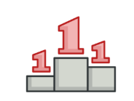
Singleton
Purpose: Ensures a class has only one instance and provides a global access point to that instance.
Use Case: Situations where a single object is needed to coordinate actions, such as configuration settings or logging.
Example: A Logger class that ensures only one instance handles all log entries.

Slide 5
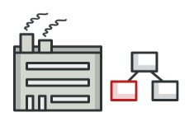
Factory Method
Purpose: Defines an interface for creating objects but allows subclasses to alter the type of objects that will be created.
Use Case: When the exact type of the object isn’t known beforehand or depends on certain conditions.
Example: A notification system that sends SMS, Email, or Push notifications based on user preference.

Slide 6
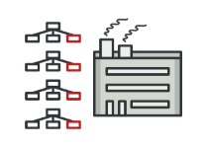
Abstract Factory
Purpose: Provides an interface for creating families of related or dependent objects without specifying their concrete classes.
Use Case: When a system needs to be independent of how its products are created and represented, or when families of related products need to be used together.
Example: A UI toolkit where an abstract factory can create widgets like buttons, textboxes, and scrollbars for different operating systems.

Slide 7
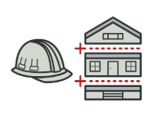
Builder
Purpose: Separates the construction of a complex object from its representation, enabling the same construction process to create different representations.
Use Case: When constructing complex objects with numerous optional parameters or configurations.
Example: Building a car with various configurations such as engine type, seating, and color.

Slide 8
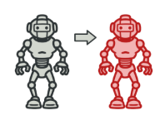
Prototype
Purpose: Creates new objects by copying an existing object (prototype) rather than creating a new instance from scratch.
Use Case: When object creation is expensive, and you need to create multiple instances of similar objects efficiently.
Example: A document editor where the user can duplicate shapes or text boxes.

Slide 9
Key Benefits of Creational Patterns:
Encapsulation of Object Creation Logic: The patterns abstract how objects are created, reducing code duplication and improving maintainability.
Decoupling of Client Code: The client code doesn’t need to know the exact class of the object being created.
Flexibility: Makes it easier to introduce new types of objects or change the instantiation process.

Slide 10
Structural Design Patterns
Structural Design Patterns
Adapter
Bridge
Composite
Decorator
Facade
Flyweight
Proxy
Deals with composition of objects and classes.
Ensure objects and classes work together effectively while maintaining flexibility and efficiency.

Slide 11
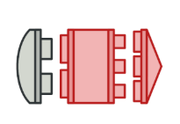
Adapter
Purpose: The Adapter pattern allows two incompatible interfaces to work together by converting the interface of one class into another that a client expects.
Use Case :
You want to use an existing class, but its interface does not match your requirements.
You need to integrate a third-party library with your application.
Example: Integrating a legacy logger with a modern logging interface.

Slide 12
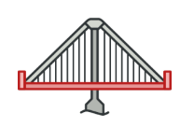
Bridge
Purpose: The Bridge pattern separates an abstraction from its implementation, allowing them to evolve independently. It avoids a rigid relationship between abstraction and implementation.
Use case:
You want to avoid a permanent binding between abstraction and implementation.
You expect that both the abstraction and the implementation might change independently.
Example: An e-commerce platform supports multiple payment gateways and payment methods. You want to:
Easily add new payment gateways without modifying existing code.
Support new payment methods without coupling them directly to specific gateways.

Slide 13
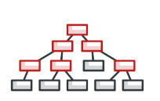
Composite
Purpose: The Composite pattern lets you compose objects into tree structures and then work with these structures as if they were individual objects. It allows clients to treat individual objects and compositions of objects uniformly.
Use case:
You want to represent a hierarchy of objects (e.g., a file system).
You want to treat individual objects and groups of objects the same way.
Example: A folder structure where files and folders are treated the same.

Slide 14
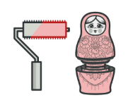
Decorator
Purpose: Adds new behavior to objects dynamically without modifying their original structure.
Use case: When extending functionality at runtime is required, without modifying existing code.
Example: Adding dynamic features to an object, such as enhancing logging functionality in a logging system.

Slide 15
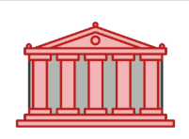
Facade
Purpose: Provides a simplified interface to a complex system by hiding its underlying complexity
Use case: When a system has multiple subsystems, and you want to expose a simple, unified api.
Example: A cloud management system interacts with multiple complex subsystems like virtual machines, storage, and networking. You want to provide a simple interface for end-users to interact with these subsystems.

Slide 16
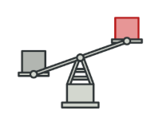
Flyweight
Purpose: Reduces memory usage by sharing common object data rather than creating multiple instances.
Use case: when an application needs a large number of objects that share common data, reducing memory overhead.
Example: Character object in a text editor where multiple instances of the same letter share the same font and style information instead of creating new objects for each.

Slide 17
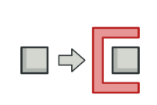
Proxy
Purpose: Controls access to an object, providing additional security or lazy loading.
Use case: Protecting expensive operations or remote object access.
Example: Controlled access to a remote service, such as a file server, by adding security checks or lazy initialization.

Slide 18
Behavioral Patterns
Behavioral Design Patterns
Chain of Responsibility
Command
Interpreter
Iterator
Mediator
Memento
Observer
State
Strategy
Template
Visitor
Define how objects collaborate and delegate responsibilities.
Improve maintainability by reducing direct dependencies.
Increase flexibility by allowing changes in behavior dynamically.

Slide 19

Chain of Responsibility
Purpose: Passes a request through a chain of handlers until one processes it.
Use case: When multiple objects may process a request.
Example: Support ticket escalation system (Level 1 → Level 2 → Manager).

Slide 20

Command
Purpose: Encapsulates a request as an object.
Use case: Implementing undo/redo functionality.
Example: A smart home system where voice commands control devices.

Slide 21
Interpreter
Purpose: Defines a grammar and interprets expressions.
Use case: Creating custom scripting languages.
Example: SQL query interpreters.

Slide 22
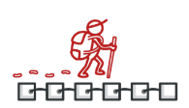
Iterator
Purpose: Provides a way to access elements in a collection sequentially.
Use case: Navigating data structures without exposing internal details.
Example: A playlist system that iterates over songs.

Slide 23
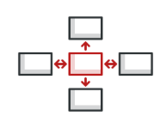
Mediator
Purpose: Defines an object that centralizes communication between objects.
Use case: When multiple components interact without direct dependencies.
Example: A chatroom where users send messages via a central mediator.

Slide 24
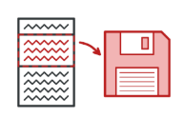
Memento
Purpose: Captures and restores an object’s state.
Use case: Implementing undo/redo functionality.
Example: A text editor’s undo history.

Slide 25

Observer
Purpose: Defines a dependency between objects, so when one changes, others get notified.
Use case: When multiple components need updates based on a single event.
Example: A stock price notification system.

Slide 26
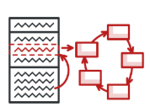
State
Purpose: Allows an object to change behavior based on its state.
Use case: When an object’s behavior varies depending on state changes.
Example: A vending machine with different states (Idle, Dispensing, Out of Stock).

Slide 27
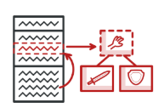
Strategy
Purpose: Encapsulates different algorithms and allows switching between them dynamically.
Use case: When multiple ways exist to perform a task.
Example: Sorting algorithms (QuickSort, MergeSort, BubbleSort).

Slide 28
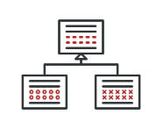
Template Method
Purpose: Defines the skeleton of an algorithm, deferring some steps to subclasses.
Use case: When a common algorithm needs customization.
Example: Online payment processing, where different banks have custom implementations.

Slide 29
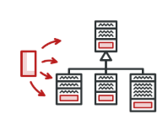
Visitor
Purpose: Adds new operations to a class without modifying its structure. Lets you separate algorithms from the objects on which they operate.
Use case: When new functionality needs to be added to a hierarchy of classes.
Example: Tax calculation for different product types in an e-commerce system.

Slide 30
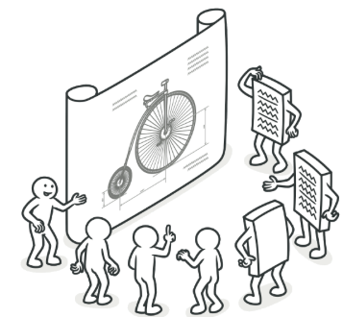
Conclusion
Design patterns provide standard solutions for common problems.
They improve code reuse, scalability, and maintainability.
Choosing the right pattern depends on the specific problem you are solving.

Slide 31
Thank you!

